Slide 1
Chapter 5
Dr. Sonal Dekhane
ITEC 3200

Slide 2
Administrative Stuff
Turn in Pre-class Chapter 5 Assignment
Review post-class chapter 4 assignment
Quiz
Reminder:
Assignments are available in the following places in D2L:
Calendar
Upcoming events
Content
Assignments
Be sure to read the “Next” section in each learning module under Content

Slide 3
Review Pre-class Chapter 5 Activity

Slide 4
Data Modeling vs. Database Design
Data Modeling
Database Design
Created during requirements analysis
High-level, user friendly
Entities, attributes, identifiers
Data types of attributes are not specified
Foreign keys are not identified at this stage
Many-many relationships exist
Created during component design
More technical, for internal purposes
Tables/relations, columns, primary keys
Data types of columns have to be specified
Foreign keys have to be identified at this stage
Many-many relationships are converted to two, one-many relationships using an intersection table

Slide 5
Chapter 5 Class Activity

Slide 6
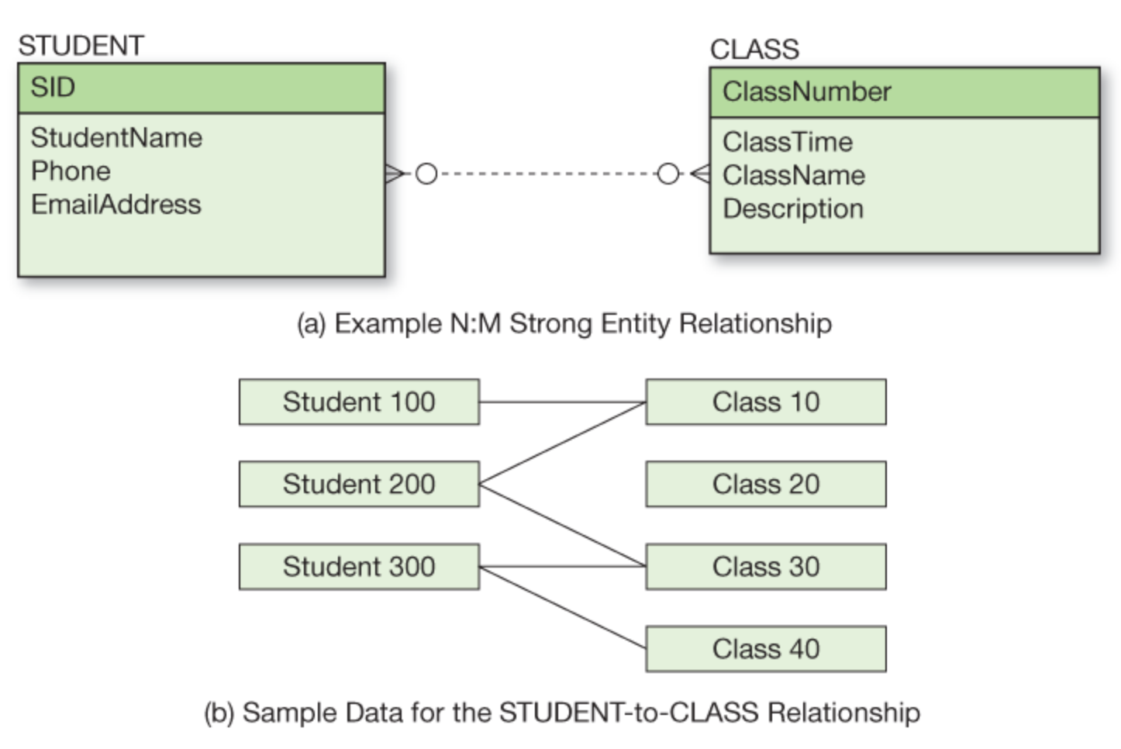
N:M Relationships

Slide 7
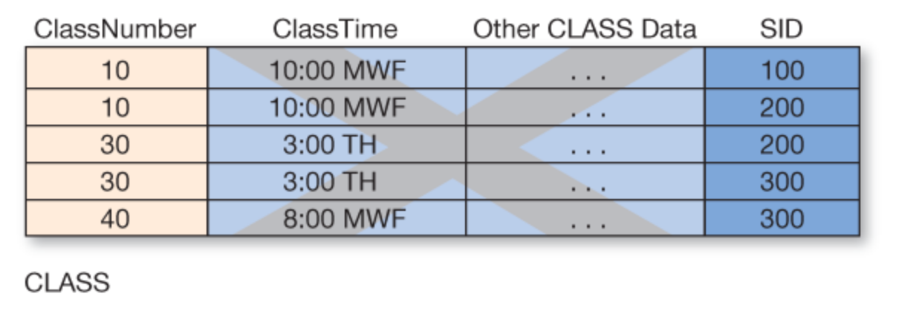
Incorrect Solution

Slide 8
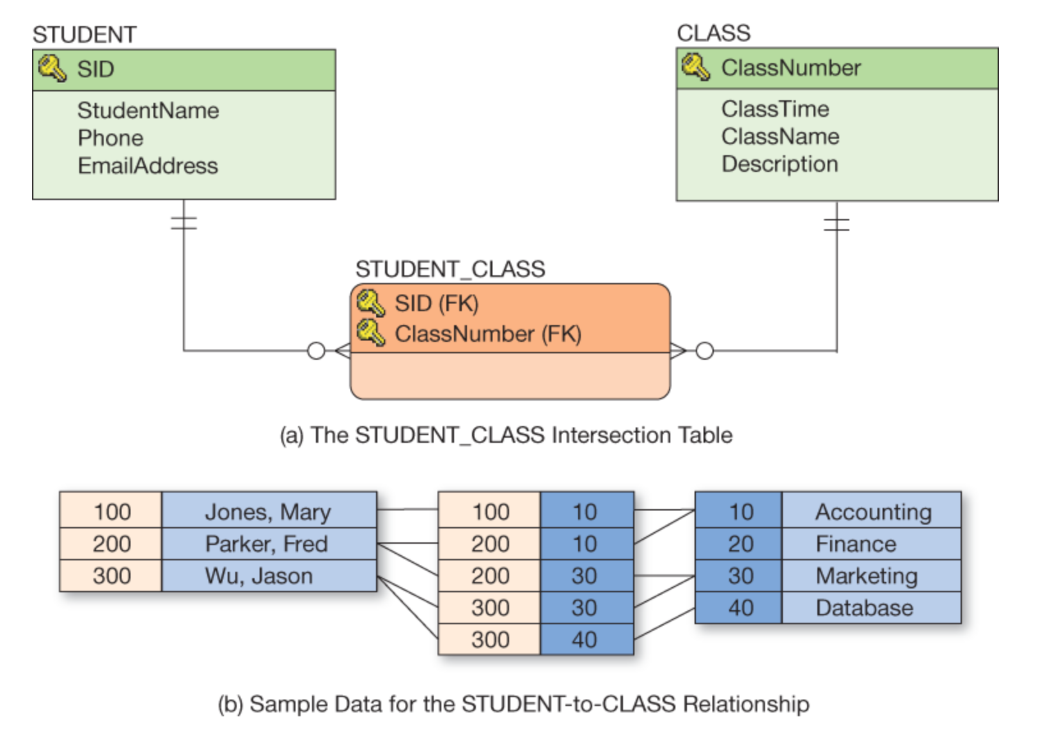
N:M Relationships
Identifying relationship
Composite primary key

Slide 9
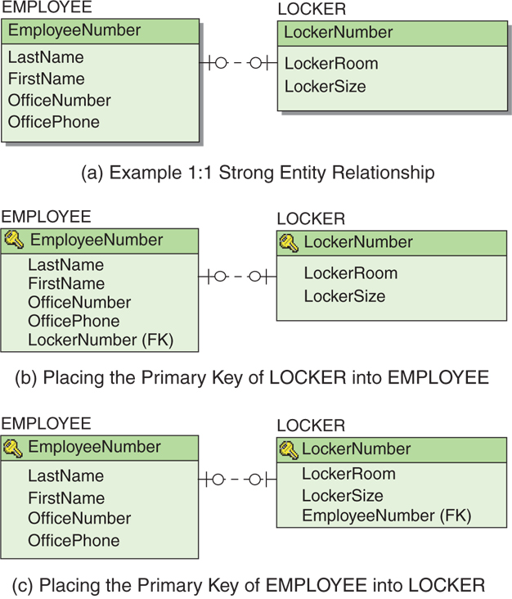
1:1 Relationships

Slide 10
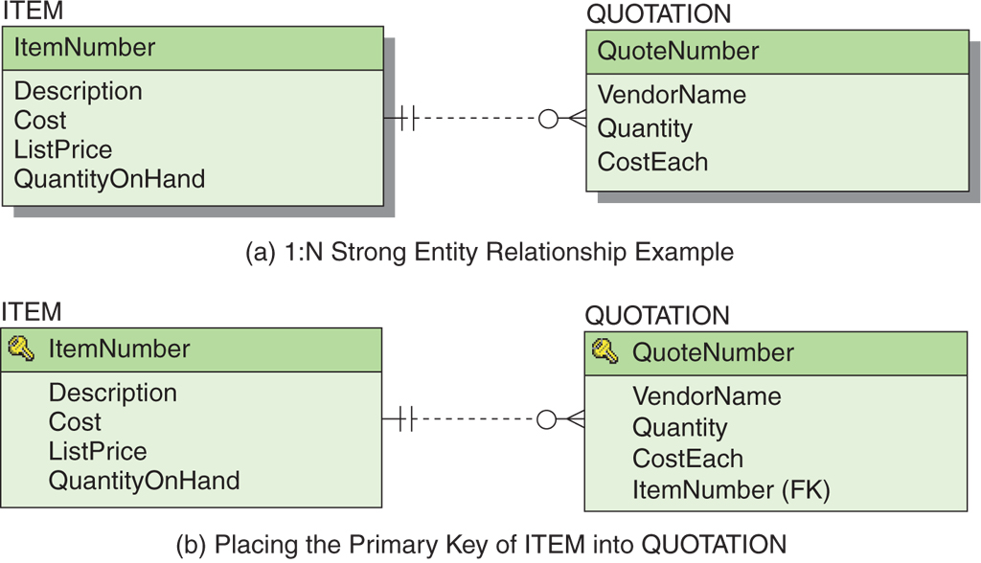
1:N Relationship

Slide 11
MySQL Data Types
Text
Char
Varchar
Numeric
Int (No decimal values)
Float (Decimal values up to 7 decimal digits)
Double (Decimal values up to 14 decimal digits. Use for scientific calculations)
Decimal (Similar to double. Use for business/money calculations)
Date/Time
Date
Time
DateTime
References
https://www.tutorialspoint.com/mysql/mysql-data-types.htm

